Slide 1

Program on Developing Windows Store Applications Using HTML5 and JavaScript

Slide 2

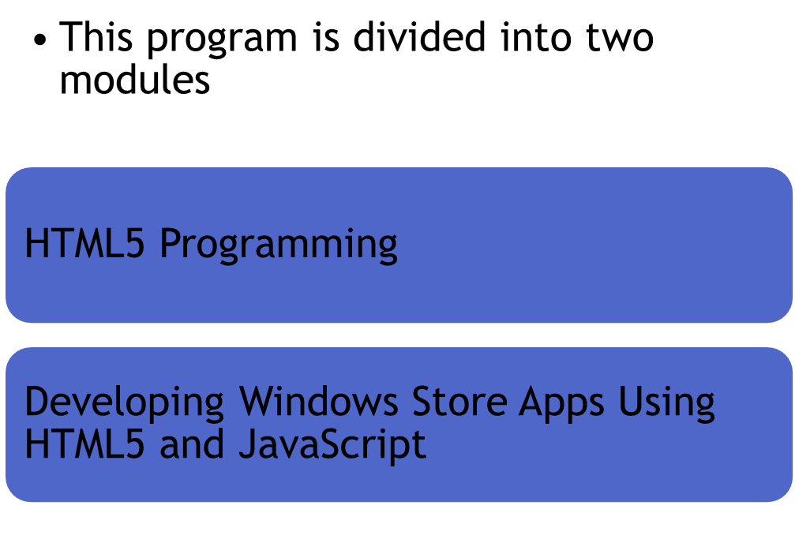

Slide 3

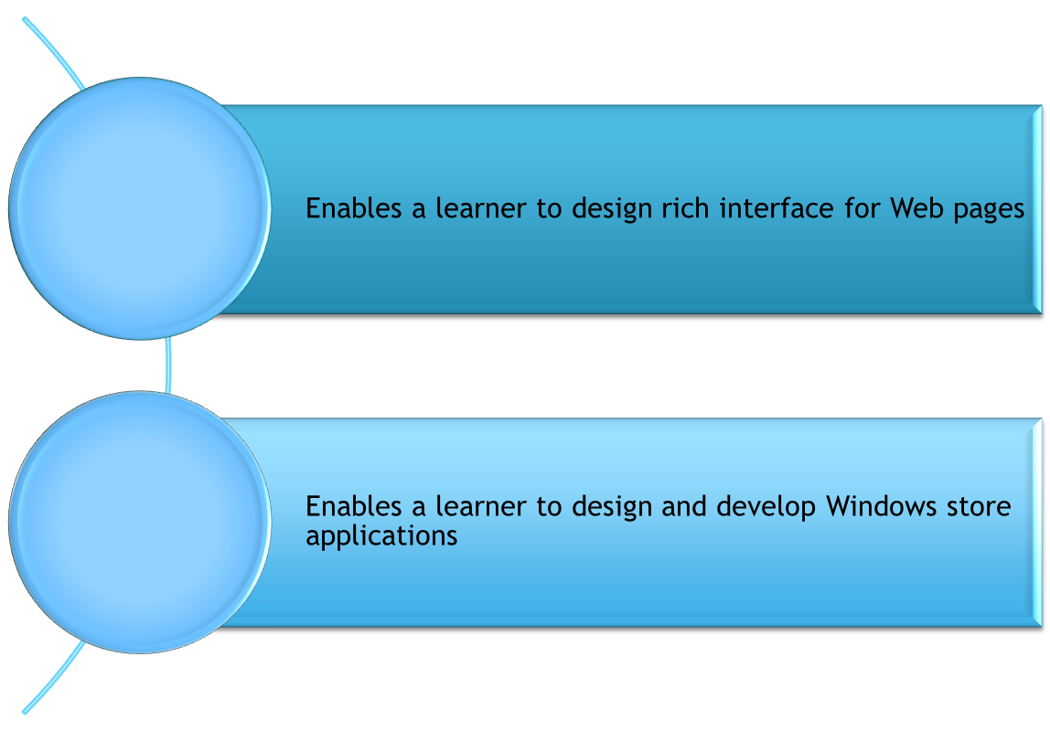

Slide 4

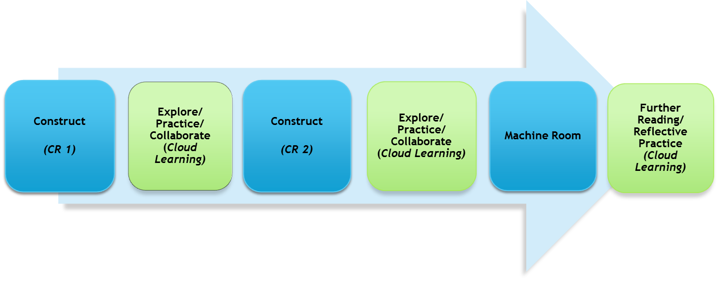

Learning at center
Learning at home/anywhere
Notes:
Explain the complete learning cycle and align it with the learning model discussed in the previous slide. State that the duration of each session is 2 hours.
After each CR session, the students need to go through additional learning components provided as part of Cloud learning. These components are available on the Collaborative portal. These components include:
Reference links
Best practices
Recorded lectures
In addition, as part of this Lab@home session, students are expected to complete the Lab exercise at home.
The Lab exercises are given as part of the courseware. The details of the exercises to be performed at home will be provided in the session plan.
These exercises need to be completed without the Faculty / Expert intervention. Hints will be available to facilitate exercise completion. Further, explain that three hints will be available to the students for help. The first two hints will provide pointers for performing the exercise. The third and last hint will provide the complete step-by-step solution for performing the exercise. These hints will be available as links in the courseware. The input data files will be available as link in the courseware.
Also discuss that the fifth session of the week will be a Proctored MR session. As part of this session, the students will be assigned a few exercises from the exercises that they have already performed as part of lab@home. The students need to complete these exercises in the machine room. The time allotted for performing these exercises will be 1.5 hrs. The Faculty will evaluate these exercises in the remaining 0.5 hour. If evaluation is not completed within 2 hours slot, solutions need to be submitted for evaluation outside the 2 hours slot.
Towards the end, explain that they also need to do one hour of e-learning every week.

Slide 5

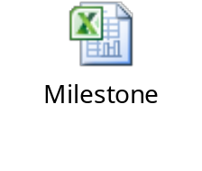

Slide 6

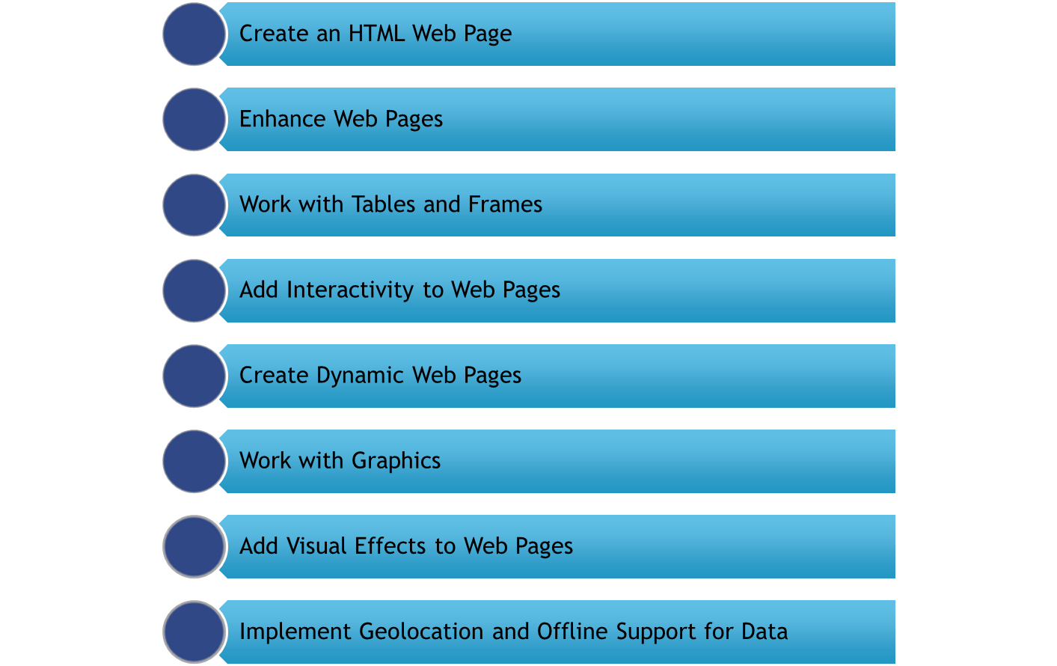

Slide 7

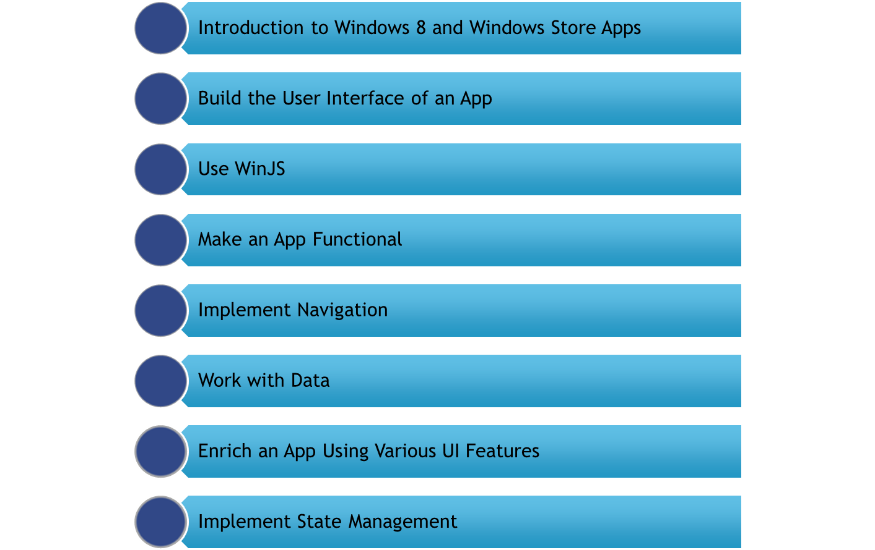

Slide 8

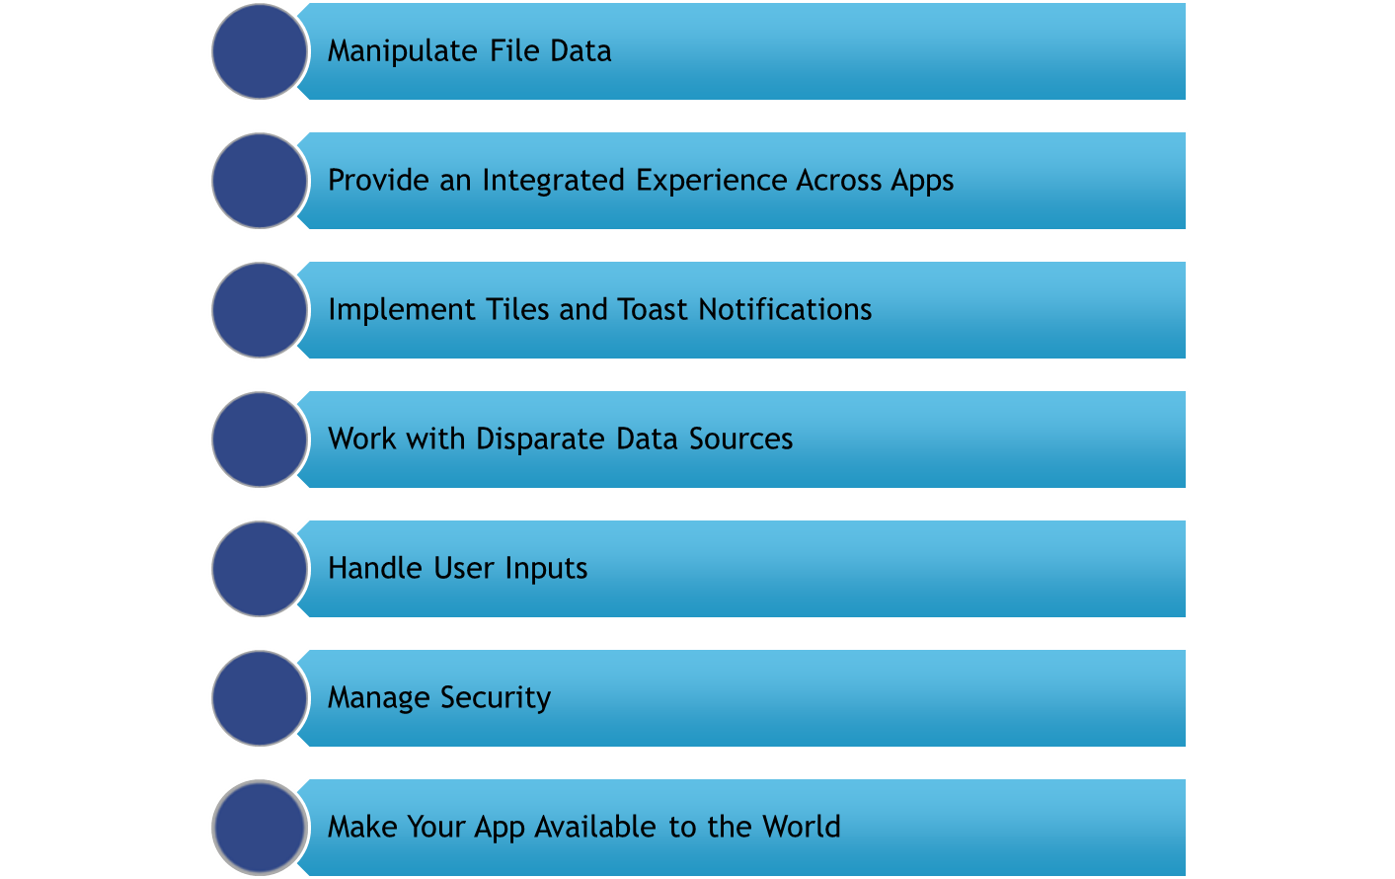

Slide 9

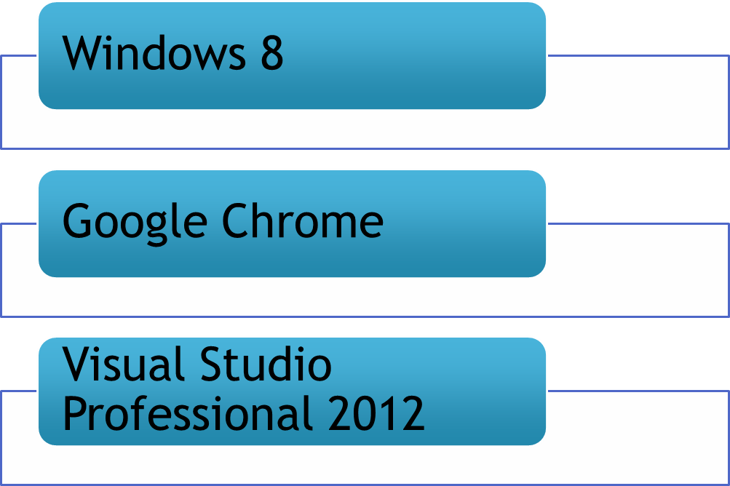

Slide 10

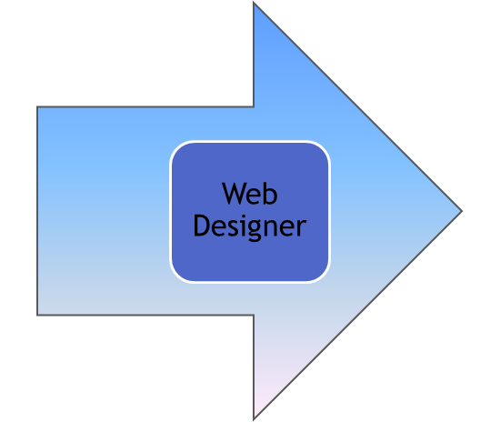
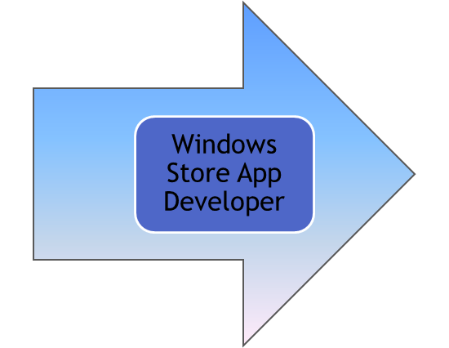

Slide 11

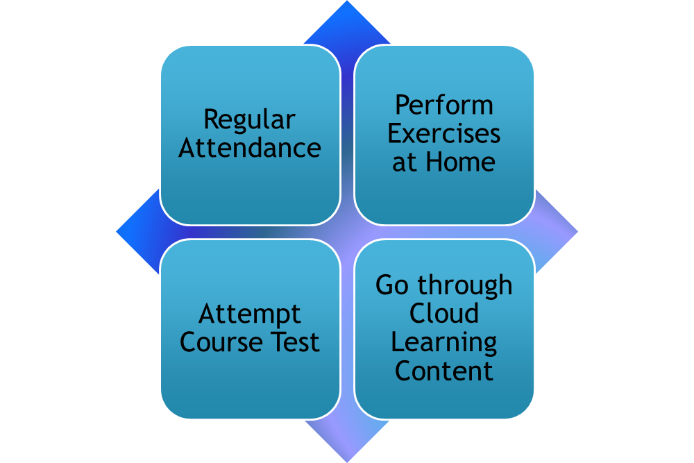

Slide 12


